Slide 1
Studying EU-Russian Relations: Theories and Methods in Russia and Abroad
Tatiana Romanova
t.romanova@spbu.ru

Slide 2
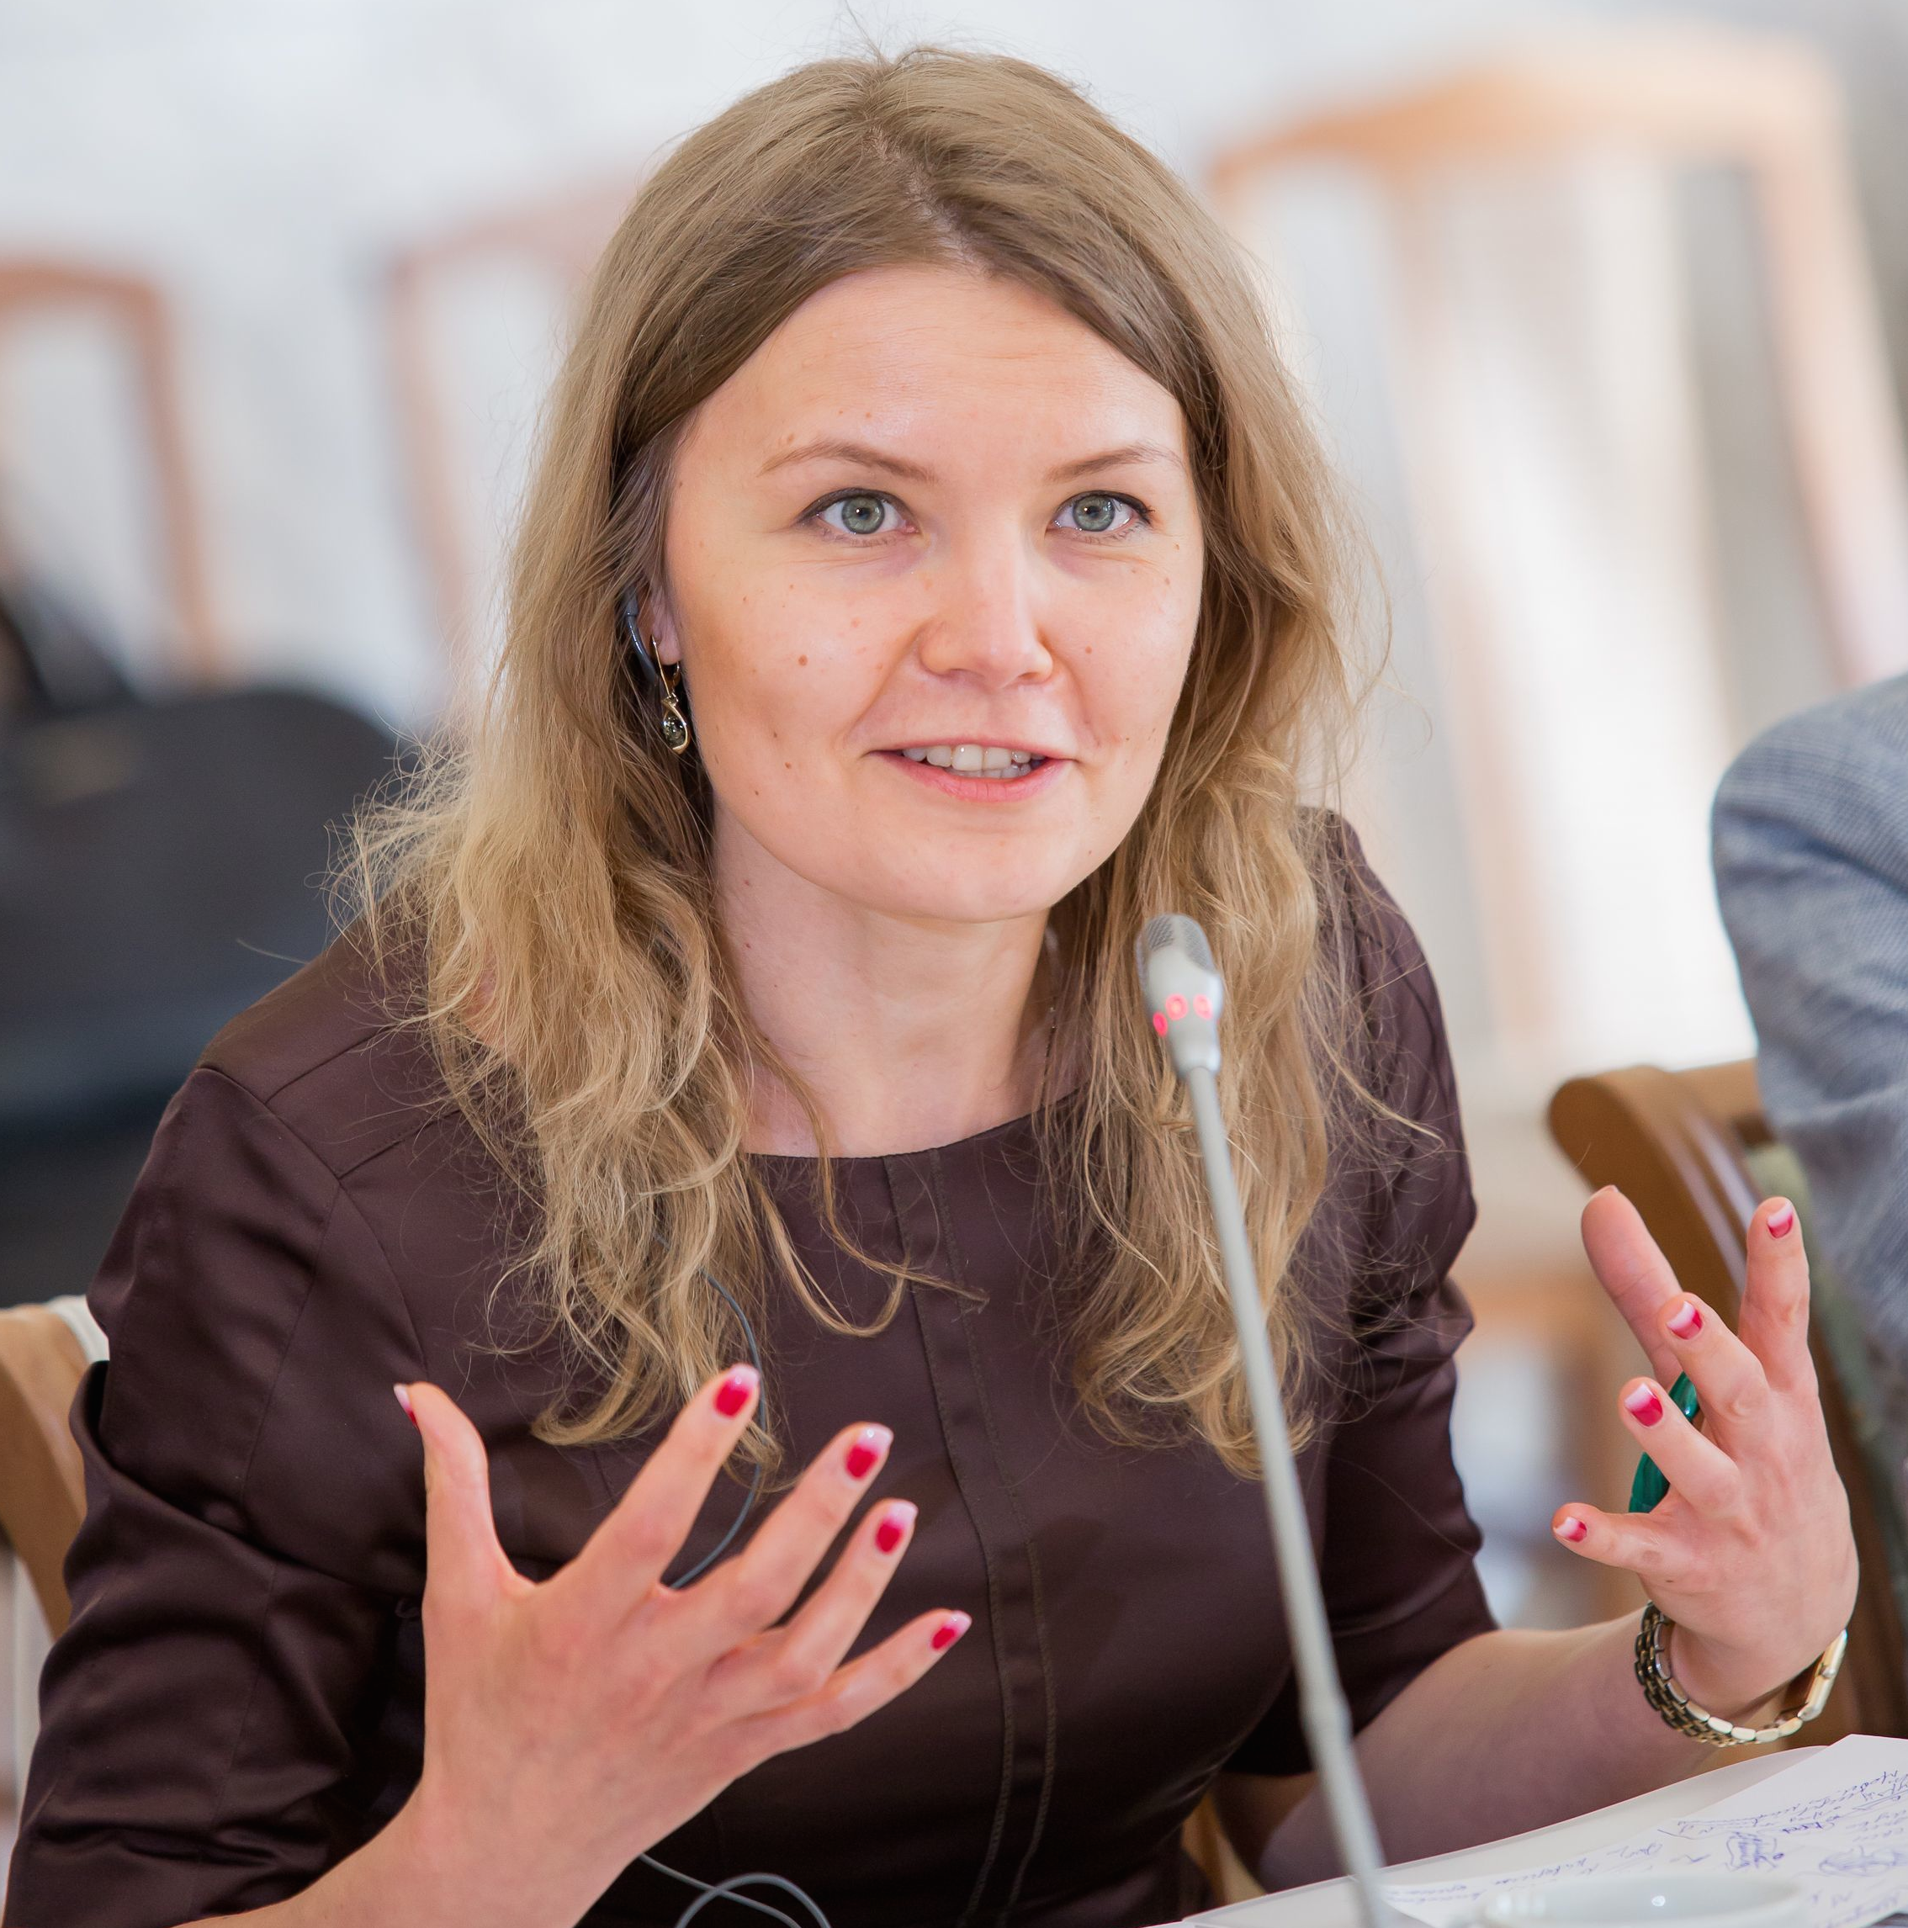
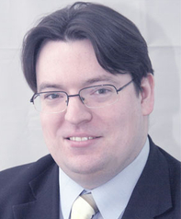
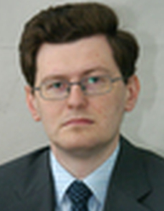
Jean Monnet Centre
Teaching track
Lectures of our courses (ppt + videos)
Model EU
Students’ debates
Research track
Looking at how EU-Russian relations have been studied in the last 25 years in Russia and in the EU (Russian – non-Russian)
www.euactive.ru

Slide 3
Some general remarks – 1
In Russia
About 60 books on EU-Russian relations with major academic publishers (including collections of articles)
More articles but even in specialised journals – less than 5%
Outside Russia
About 45 books on EU-Russian relations with major academic publishers (including collections of articles)
More articles but do not dominate the agenda (although there have been a few special issues)
EU-Russian relations have not become central to the research agenda in either Russia or the EU, despite the relative importance of the two players for each other

Slide 4
Some general remarks – 2
Traditions of socio-economic studies in Russia:
Historical approach
Systemic approach
Empirical analysis → descriptiveness + certain disgust for theories as something artificial or their application to other cases but Russia
Realism (and its modifications) as the only acceptable paradigm
Traditions of Western research
Much more theory-driven (2 traditions: Russia as a case study vs. Russia’s specialists)
EU studies have moved from international relations to political science
Studies of relations with external actors rather dominated by IR (although europeanisation, institutionalism…)
More in tune with the evolution of social sciences in general (constructivist and poststructuralist turns)
Limited interpenetration
Recent trend on both sides: academic studies to support official positions → varying paradigms to the EU and Russia + self-censorship

Slide 5
Key theories / approaches - 1
Realism, Geopolitics and Systemic Approach
Realism is present on both sides
Recently became central (especially geopolitical focus)
Issue-driven – Russian
Theory-driven – non-Russian
Russian scholars like emphasising systemic factors (global but also processes in the EU) whereas on the EU’s side we see mostly focus on Russian internal politics and motivation
Focuses: energy, hard security and neighbourhood
Recently dependence rather than interdependence is emphasised
Legal Methods, Liberalism and Institutionalism
More popular outside of Russia
EU is frequently the arena for testing various institutionalist theories
Non-Russian approaches:
realist Russia vs. liberal EU
relative advantage of the EU in this paradigm
need to further strengthen EU’s institutions
Seen as mostly old fashioned and belonging to the 1990s in Russia
Russians approaches:
lawyers → class.institutionalism
difference in the approaches to law (letter of law vs. spirit of law)
difference between the situation inside the EU vs EU-Russian relations (general problem of internal vs international)

Slide 6
Key theories / approaches -2
Constructivism
By far more spread in non-Russian studies
but more frequently to the EU than to any other actor or relations
Russian scholars frequently use it without admitting it
identity, perceptions, Europeanness, the Baltic region
shallow analysis of the EU and EU-Russian contradictions as a result
EU scholars actively use it, mainly because of the nature of the analysis of the EU
Russia as a meaningful other for the EU / Europe
(foreign policy) identity (and the role of norms in it) → PCA, ND, ENP, P4M
Economic Theories and Methods
Attracts lots of Russian scholars, mostly empirically-driven
overall trade, investments, sanctions
statistical analysis
efforts to copy the EU’s experience in the Eurasian integration (some theoretical generalisation as well)
Political economy mostly on the EU’s side
Qualitative changes (including public-private, influence of the WTO, Eurasian integration, sanctions)
Particular focus on energy relations
Short-term approaches rather than long-term forecasts

Slide 7
Key theories / approaches - 3
Normative Power Debates
Non-Russian studies:
linked to the specificity of the EU
draw on civilian and soft power
discussions on its elements
constructivist approach
Russia – as a case-study (perception, meaningful other, challenge)
Delayed arrival to Russia:
applied to the EU but not EU-Russian relations (with long discussions why)
realist approach and some historical analysis
efforts to theoretically classify Russia’s objections to the normative power
Most recently: efforts to distinguish between normative and soft power
Norms vs. values discussion acquired different tonality in Russia and the EU
Europeanisation
Difference between europeanisation and EU-isation (→ what it Europe)
Russian studies:
Difference between historical studies of europeanisation and EU’s europeanisation
Europeanisation of education, Russian law, Russian economy… → instrumental vs normative europeanisation
Non-Russian studies:
Areas and degrees (concentric circles, thin and thick europeanisation)
Russia as a case of limited EU-isation (Russia’s resistance vs. europeanisation of some policies)
Russian influence on europeanisation in the shared neighbourhood

Slide 8
Realism, Geopolitics and Systemic Approach
Legal Methods, Liberalism and Institutionalism
Constructivism
Economic Theories and Methods
Normative Power Debates
Europeanisation

Slide 9
THANK YOU FOR YOUR ATTENTION!

